Slide 1
Department of Artificial Intelligence and Machine Learning
com
EVEN SEM AY 2021-22
Gate previous year question papers
Group Members: 1) Yoshit Verma - 58
2) Vedanto Wadekar - 59
3) Nidhi Worah - 60
Date: 04-05-22

Slide 2

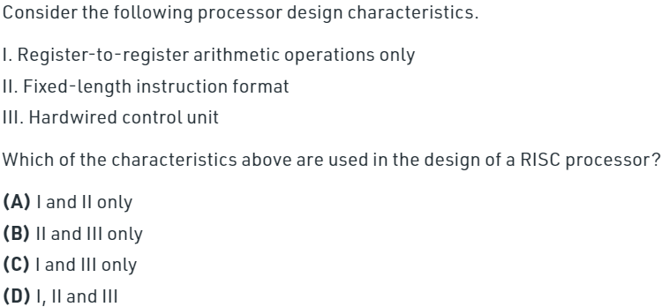
Questions

Slide 3
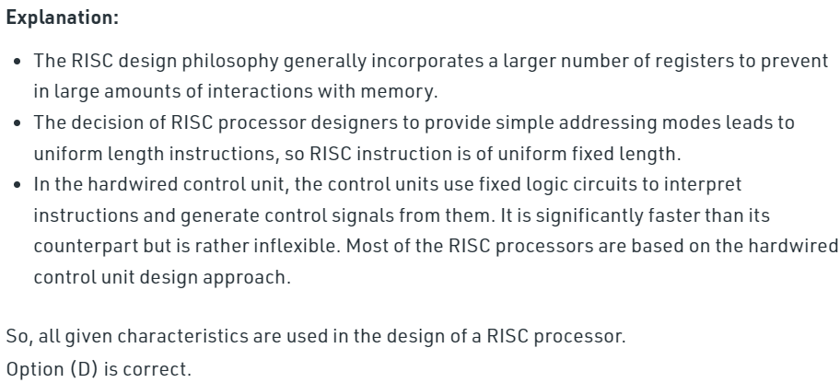
Answer

Slide 4
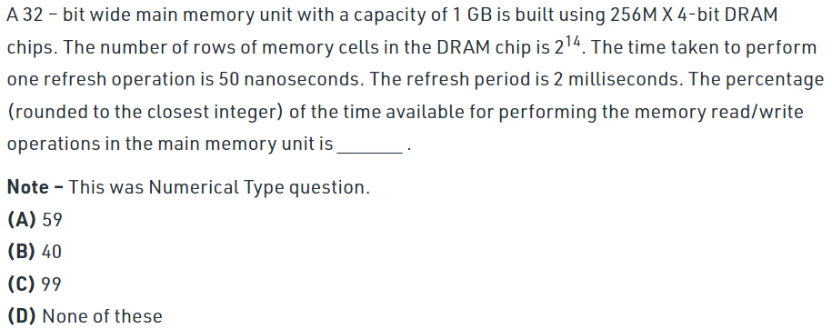
Questions

Slide 5
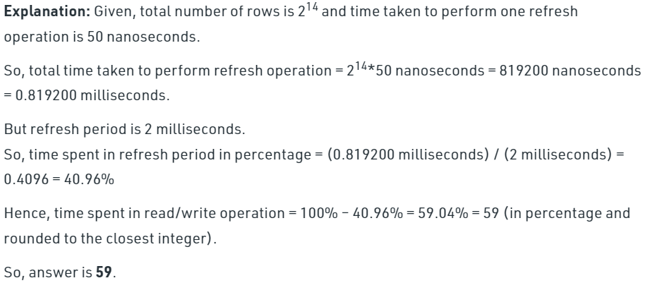
Answer

Slide 6
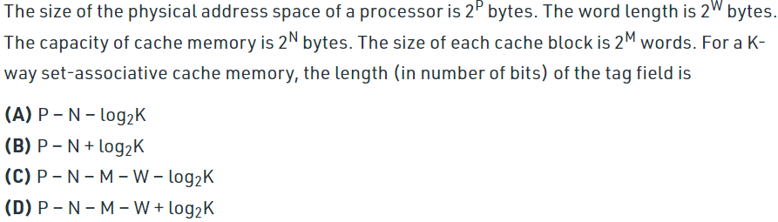
Questions

Slide 7
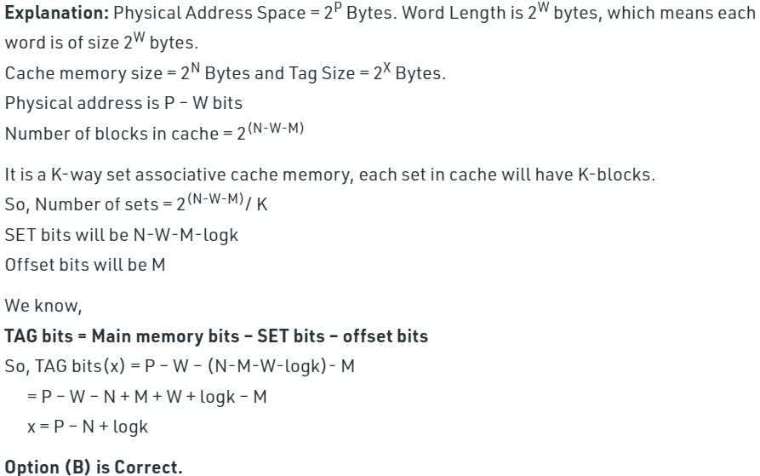
Answer

Slide 8
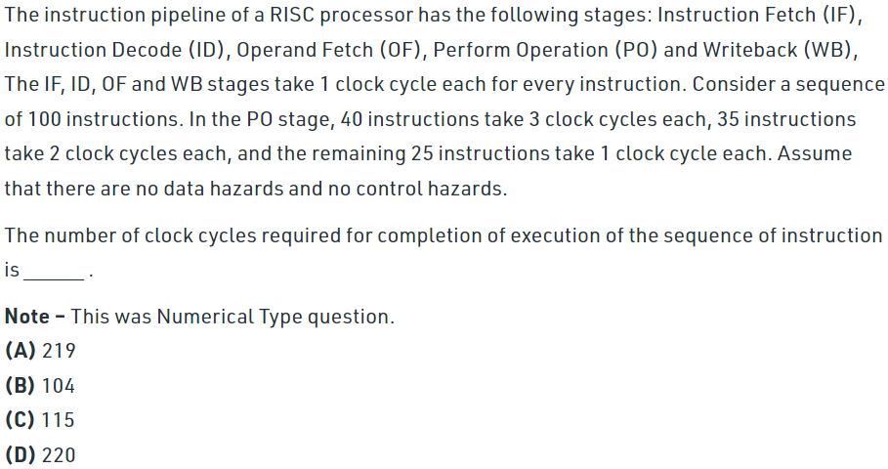
Questions

Slide 9
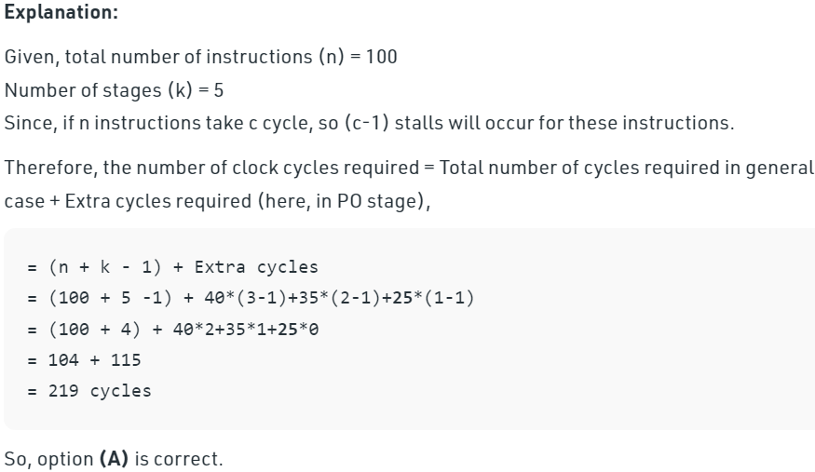
Answer

Slide 10
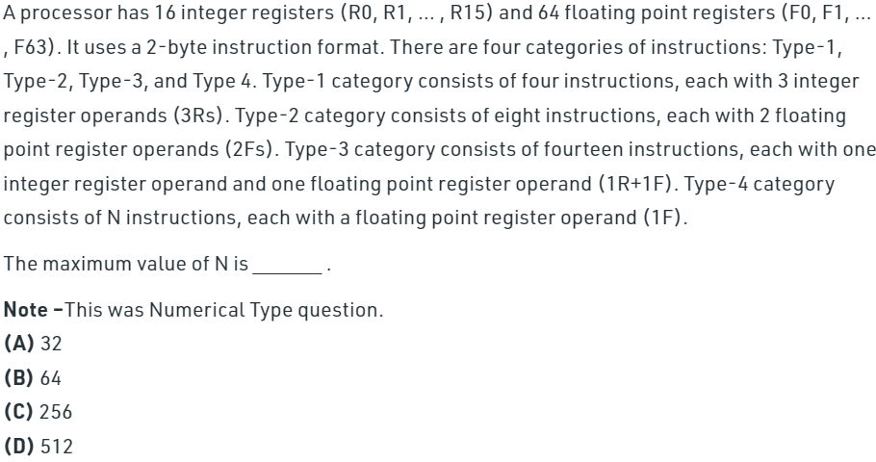
Questions

Slide 11
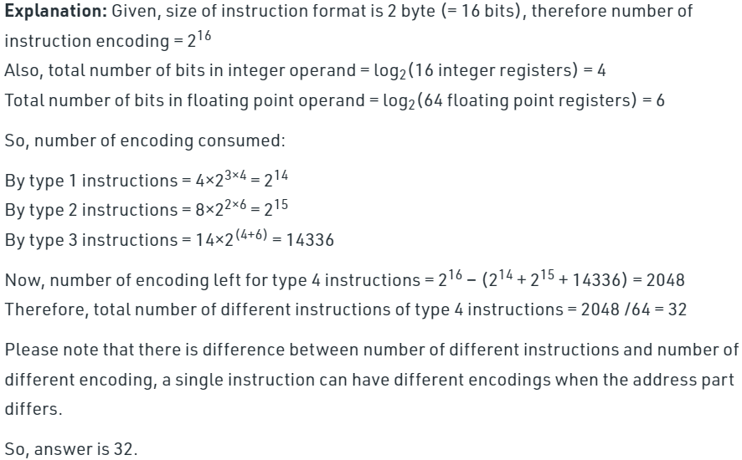
Answer

Slide 12
.
Thank you!

